Slide 1
Digital Libraries in Kenya: Current Practice and Future Prospects"
Dr. Wanyenda Chilimo

Slide 2
Outline
Libraries in Kenya – Historical background
Academic Libraries in Kenya
Digital Libraries
E-resources (Access to E-journals and e-books)
Automated library services
Institutional repositories and Open access
Challenges and future prospects
Conclusion

Slide 3
Back ground
The history of libraries in Kenya can be traced back to late 1800 when Kenya was still a British colony (Otike 1987)
The first libraries were established to facilitate the activities of a newly established colony
These libraries were later transformed into special libraries and research libraries, Examples of these include e.g.
High Court Library - 1895
Agriculture and veterinary research libraries – 1907
Attorney General Library – 1914
Kenya Museum Library – 1907
The earlies pubic libraries were
Sir Bin Salim public library and reading Room - 1903
MacMillan Library - Established for the European Community - 1925

Slide 4
Back ground
The first public library services started in the year 1948 with the establishment of Kenya National Library Services Board which was empowered to promote, equip, manage, maintain and develop libraries in Kenya (Otike 1987)
The board was mandated to establish library services for citizens through out the country. Currently there are 64 branches in cities, towns and Counties through out Kenya
In academic institutions the earlies libraries include
Royal Technical College (1957) – Currently University of Nairobi
Egerton College (1940) – Currently Egerton University
MIOME (1948)– Currently Technical University of Mombasa

Slide 5
Academic Libraries in Kenya
Over the past few years, there has been a tremendous increase in the number of universities in Kenya
The total number of universities in Kenya has increased from 13 in 2001 to, currently, 77 universities, which include public, private and constituent colleges (CUE 2022).
The development of Digital libraries has gone hand in hand with the establishment of universities in Kenya as each university is required by law to have a well established and well functioning library system

Slide 6
Academic Libraries in Kenya
The commission for university education (CUE) Standards for University Libraries in Kenya 2013, under LIBR/STD/03 states that “A university library shall adopt and maintain Information Communication Technologies in information management and its operation”
In compliance with this standard and in order to meet to expectation of users (especially the youth) who are increasing becoming tech-savvy, establishing digital libraries becomes a matter of necessity.

Slide 7
Digital libraries
Managed collection of information, with associated services, where the information is stored in digital formats and accessible over a network (Arms 2000)
Digital Libraries are also referred to as electronic libraries, online libraries, virtual libraries, internet libraries, digital repository, digital collection etc.
Libraries without walls, Virtual libraries or hybrid libraries. Materials in these libraries can include text, still images, audio, video. These can be digitized content like print or photographs as well as originally produced digital content
The presentation will cover
E-resources (Access to E-journals and e-books)
Automated library services
Institutional repositories and Open access

Slide 8
E-resources (Access to E-journals and e-books)
Electronic resources (E-resources) are information sources available online and are accessible through the use of a computer.
Traditionally, libraries have been a collection of books, journals, manuscripts and other print information, however this is changing due to advancements in ICTs
Many academic libraries have transitioned into hybrid environments fulfilling the educational, recreational and information needs of their clients.
Electronic resources provide users with timely information, being updated frequently. In addition, they provide wide-ranging links to additional resources
Libraries in Kenya provide access to e-resources by subscribing to subject specific electronic database organised for ease search and retrieval of information

Slide 9
E-resources (Access to E-journals and e-books)
Libraries in Kenya collectively subscribes to electronic resources by means of cost sharing as a way of coping with the raising cost of information resources
All academic libraries are members of Kenya Libraries and Information Services Consortium (KLISC)
KLISC negotiates for subscription rates and Licensing agreements for electronic resources on behalf of its members within reasonable financial considerations.
Through membership to KLISC libraries have access to millions of full text electronic academic journals and books provided by publishers such as Ebsco host, IEEE, Emerald etc.

Slide 10
E-resources – Challenges and future Prospects
High cost of subscription to E-resources which makes some databases out of reach to Kenyan Universities e.g. Elsevier, Scopus and Web of science databases
Underutilization of the resources by staff and students
Inadequate skills among library staff hence the need for frequent training programs and capacity building
Low bandwidth and inadequate ICT infrastructure within the universities which makes accessibility a challenge

Slide 11
Automated library services
Majority of academic libraries in Kenya have automated their services
Through automation libraries are able to utilize information communications technologies (ICT) to replace manual systems. This bring efficient and effectiveness in operations
A study done by Adera 2013 shows that 67% of libraries in Kenya were using KOHA as their library software
The main reason for this trend is the cost-effectiveness associated with the use of open source systems.
In most cases, academic libraries in Kenya are inadequately funded but are under pressure to provide quality library services to their users. This scenario makes open source systems an attractive option for these libraries
Other advantages of using Koha include lower initial and ongoing costs, the absence of vendor lock-ins and allowing for greater flexibility.

Slide 12
Automation - Challenges and future Prospects
However, managing open source LMSs also comes with challenges. The main challenge is lack of quality support services or a dedicated vendor company to maintain the systems for the libraries
Though free and paid Koha support services are also available through the Koha Kenya Community (2014), However this is not adequate, Libraries using Koha are still faced with challenges including:
lack of skills, knowledge, and competencies to effectively use Koha.
Inability to effectively use all the modules in Koha because of a lack of skills. The modules that are mainly used are circulation and cataloguing modules.
Difficulties upgrading and backing up the Koha database.
Difficulties involving integrating KOHA with other systems in the universities e.g. Finance, student management system
Inadequate hard ware, networking infrusttacture and other IT facilities

Slide 13
Institutional Repositories and open access
Institutional repositories (IRs) have emerged alongside the open access (OA) initiative on scientific literature which advocates for free, online access to digital scholarly materials (Ferreira et al. 2008)
Institutional repositories are important tools in facilitating global access to the institutional generated intellectual output and making it visible globally
Open access services through institutional repositories have the potential to maximize access and impact, and accelerate the dissemination of research output generated from African countries
This will in turn improve visibility of African researchers to global knowledge (Jones, 2018)

Slide 14
Institutional Repositories and open access
Statistics from global Directory of Open Access Repositories (OpenDOAR) shows that:
Europe has 1,938 Repositories
America has 1,204 Repositories
Asia has 842 Repositories
Africa has 213 IRs
Oceania has 101 Repositories (OpenDOAR, 2019).
In Africa OpenDOAR places Kenya as the second-largest contributor of Repositories in Africa, after South Africa based on the number of repository counts

Slide 15
Institutional Repositories and open access
Kenya has experienced rapid development of IRs over the past few years
The number of IRs in Kenya listed in OpenDOAR rose from two in 2009 to 46 in 2022.
In addition, many more universities are in the process of developing their repositories. Some of them are already on the World Wide Web (or Web) but not yet listed in OpenDOAR, and some still operate on their institutions’ local area network (LAN)

Slide 16
Institutional Repositories in Kenya
From 2000 Kenya Library and Information Services Consortium (KLISC) with support form International Network for Advancing Science and Policy (INASP) played an important role in encouraging the implementation of institutional repositories in Kenya (Ratanya 2017)
KLISC conducted rigorous training in Open Access and Institutional Repositories to sensitize KLISC member institutions.
In addition, KLISC conducted Open Access workshops and conferences through the support of Eifl.net and INASP.

Slide 17
Institutional Repositories in Kenya
Majority of the institutions that participated in these workshop have established or are in process of establishing IR
This greatly contributed to the success of institutional Repositories in Kenya
Majority of the repositories in Kenya are established using the Dspace software
KLISC is currently conducting similar workshops on various related topics including: Open Science, open data, open journal system (OJS) etc.

Slide 18
IR and OA at Technical University of Mombasa
Technical University of Mombasa (TUM) established it first IR in 2015
Currently TUM has three repositories
The University repository available at http://ir.tum.ac.ke/ Content available in this repository include journal articles, book chapter, Thesis and Dissertation, Conference proceedings etc The university intellectual output
The past examination paper databank https://erepository.tum.ac.ke/
Coast week Newspaper archives http://41.89.128.49/ A collaborative project developed by Technical University of Mombasa and Coastweek, a community newspaper that presents a unique rich historical legacy of the Coast region of Kenya. The newspaper was published weekly from 10th November 1978 to 31st December, 2018

Slide 19
IR and OA at Technical University of Mombasa
The University is hosting a scholarly Journal called the Multidisciplinary Journal of Technical University of Mombasa https://journals.tum.ac.ke
The journal is hosted using the Open Journal System
Technical aspects of the journal management are handled by the library. These include :
Installation of the Journal management system
OJS system maintenance, upgrading, back up and server administration
ISSN Registration
DOI registration and metadata Registration with Cross Ref

Slide 20
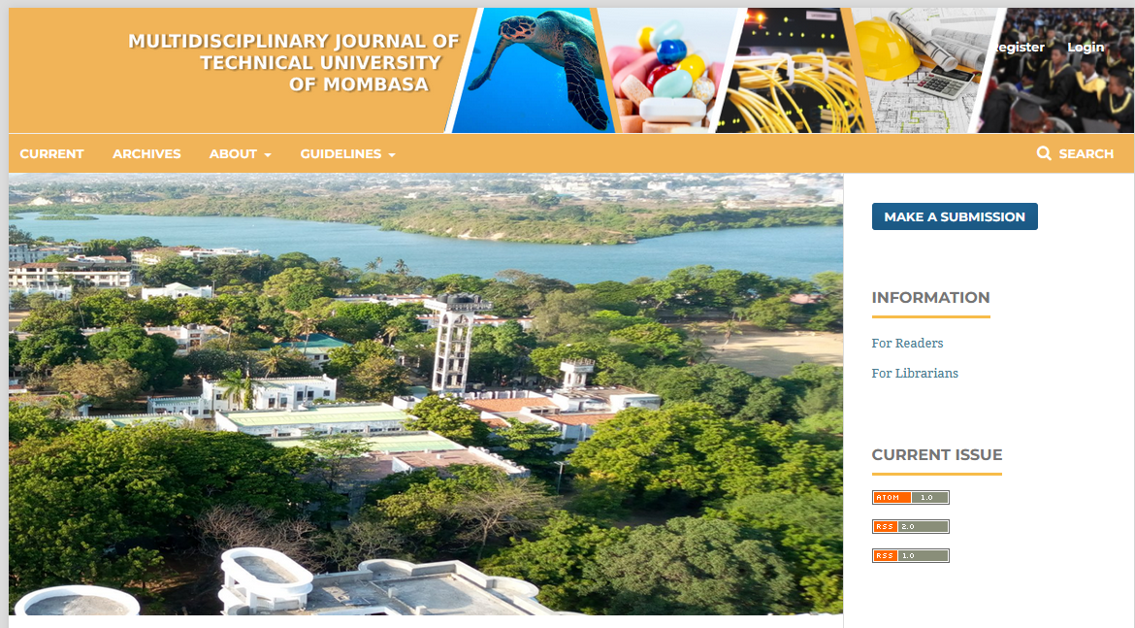

Slide 21
Challenges and future Prospects
Lack of awareness of open access institutional repositories among researchers and academics
Inadequate content in the repositories: Most university have policies that mandates academics to deposit copies of their publications in the repositories, however, enforcing these mandates is a challenge
Low level of performance of the repositories. Study by Adam and Kaur (2022) reported that, globally, African IRs have not been able to penetrate into the top 100 ranked IRs by Transparent Ranking, though four have managed to be listed in the top 200. (SA and Sudan)
There is need to embrace the culture and practice of open science by adopting and implementing other open science element based on UNESCO recommendation e.g. open data, open evaluation etc

Slide 22
Conclusion
Despite the challenges libraries in Kenya are making some progress in implementing digital libraries
A lot of progress made so far has been through partnership and collaborations with institutions, projects within and outside Kenya
My institution is continuously seek such partnerships for sharing experiences, capacity building and mutual benefits between institutions

Slide 23
References
Adam, U. A., & Kaur, K. (2022). Institutional repositories in Africa: Regaining direction. Information Development, 38(2), 166–178. https://doi.org/10.1177/02666669211015429
Adera, B. A. (2013). Feasibility of adaptation of open source ILS for libraries in Kenya: a practical evaluation. The Electronic Library.
Arms, W.Y. (2000), Digital Libraries, MIT Press, Cambridge, MA
CUE (2014) Standards for University Libraries in Kenya 2014. https://www.cue.or.ke/index.php?option=com_phocadownload&view=category&id=16:standards-and-guidelines&Itemid=187
CUE (2022). Status of Universities. https://www.cue.or.ke/index.php?option=com_content&view=article&id=21&Itemid=189
Ferreira, M., A. A. Baptista, E. Rodrigues and R. Saraiva. 2008. Carrots and sticks: Some ideas on how to create a successful institutional repository. D-Lib Magazine 14(1/2)
Jones W. R. (2018). Institutional Repositories and Usage: Thoughts on Realized and Potential Value. Public Services Quarterly, 14(4): 386–391
OpenDOAR, (2019). Repositories by Countries https://v2.sherpa.ac.uk/opendoar/
Otike J (1987). Development of libraries in Kenya. http://www.innovation.ukzn.ac.za/InnovationPdfs/No28pp1-8Otike.pdf Retrieved on 27th May 2010. 28.
Ratanya F. C. (2017). Institutional repository: access and use by academic staff at Egerton University, Kenya. Library Management, 38(4/5): 276–284.

Slide 24
Appreciation
Transcultural Perspectives in Art and Art Education (TPAAE) - The project has received funding from the European Union’s Horizon 2020 research and innovation programme under the Marie Skłodowska-Curie grant agreement No 872718
Academy of Art in Szczecin (Poland) – coordinator
National Museum in Szczecin (Poland)
West Pomeranian University of Technology libraray

Slide 25
THANK YOU Dziękuję Ci

